Slide 1
Energy Consumption Analysis
DW 75 DW 76
Akshaya. N

Slide 2
Problem Statement
Title: "Analysis of Energy Usage and GHG Emissions in Ontario's Broader Public Sector (BPS)"
Subtitle: "Towards Sustainable Practices and Climate Change Mitigation“
Project Goal: Analyze energy usage and GHG emissions within Ontario's Broader Public Sector (BPS) organizations.
Database Utilization: Leveraging a comprehensive database of reported data for a thorough examination.
Objectives:
Identify Trends in Energy Consumption and GHG Emissions.
Assess Conservation Effectiveness within the BPS.
Pinpoint Areas for Improvement.
Purpose: Inform data-driven strategies to achieve climate change mitigation goals within the BPS.

Slide 3
TOOLS USED
Microsoft Excel
Excel Power Query
Microsoft Power BI

Slide 4
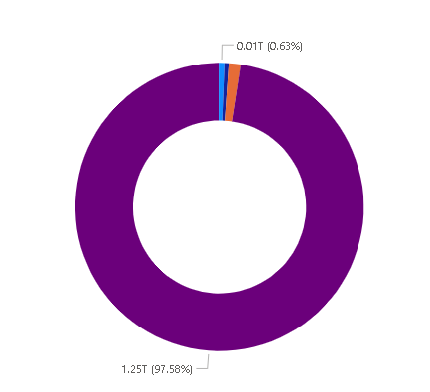
Sectors
97%
0.063%
School Board
Municipality
1.31%
0.47%
Public Hospital
Post Secondary Educational Instutions
Venus is the second planet from the Sun

Slide 5
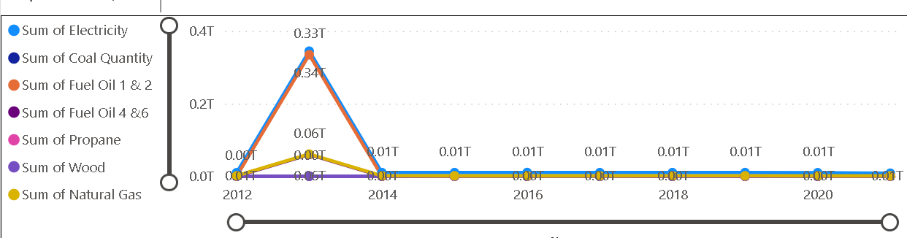
Energy consumptions
Year | Wood | Natural Gas | Propane | Fuel Oil 4 &6 | Fuel Oil 1 & 2 | Electricity | Coal
2012 | 275275 | 1044904767 | 11169409.91 | 1063983.294 | 14512454.19 | 9597302417 | 174617
2013 | 9291 | 60961179165 | 13397256.19 | 59821649751 | 3.34779E+11 | 3.44638E+11 | 0
2014 | 182 | 1190883800 | 13771544.74 | 2424317 | 17782440.23 | 9967555444 | 0
2015 | 198 | 1097984653 | 13425361.41 | 702717 | 12604725.94 | 9949801647 | 0
2016 | 161 | 1043840320 | 12805935.88 | 693019.653 | 9313879.263 | 10202683133 | 0
2017 | 102 | 1108640596 | 14568002.55 | 618353.3724 | 7505169.974 | 9862042811 | 0
2018 | 247 | 1161676486 | 15955078.49 | 597115 | 7782023.454 | 9908760436 | 0
2019 | 251 | 1166235706 | 16952694.17 | 877925.9552 | 8103564.626 | 10002816889 | 1
2020 | 326 | 1101513109 | 13887288.17 | 409840.11 | 6227134.933 | 9672836265 | 0
2021 | 130 | 928830923.7 | 11246 | 13290 | 5596430 | 8280342643

Slide 6
Insights in Energy consumptions
Dominance of Natural Gas and Electricity:
Natural Gas and Electricity consistently stand out as the dominant sources of energy consumption throughout the years.
Natural Gas consumption shows an increasing trend until 2019, after which it decreases in 2020. This might be influenced by factors like energy policies, market dynamics, or shifts towards renewable sources.
Decline in Traditional Fuels:
The data reflects a notable decline in the consumption of traditional fuels like Wood and Coal.
Coal consumption drops to zero after 2016, indicating a potential shift away from coal-based energy, possibly due to environmental concerns or regulatory changes.
Fluctuations in Propane and Fuel Oil:
Propane and Fuel Oil consumption show variations over the years, suggesting potential sensitivity to economic or seasonal factors.
Propane consumption has fluctuations, while Fuel Oil 1 & 2 and Fuel Oil 4 & 6 show varying levels. Understanding the reasons behind these fluctuations could provide insights into market dynamics or changes in energy needs.
VENUS
JUPITER

Slide 7
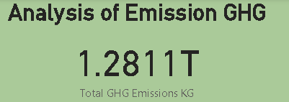
Total GHG Emission
Year | Sum of GHG Emissions KG
2012 | 3833212551.6983414
2013 | 1245569616284.691
2014 | 2936132153.0833716
2015 | 2762059055.9941254
2016 | 2628976677.2087345
2017 | 2527743282.790681
2018 | 2699083378.1937494
2019 | 12651973945.24135
2020 | 2527207563.1517987
2021 | 2986989800

Slide 8
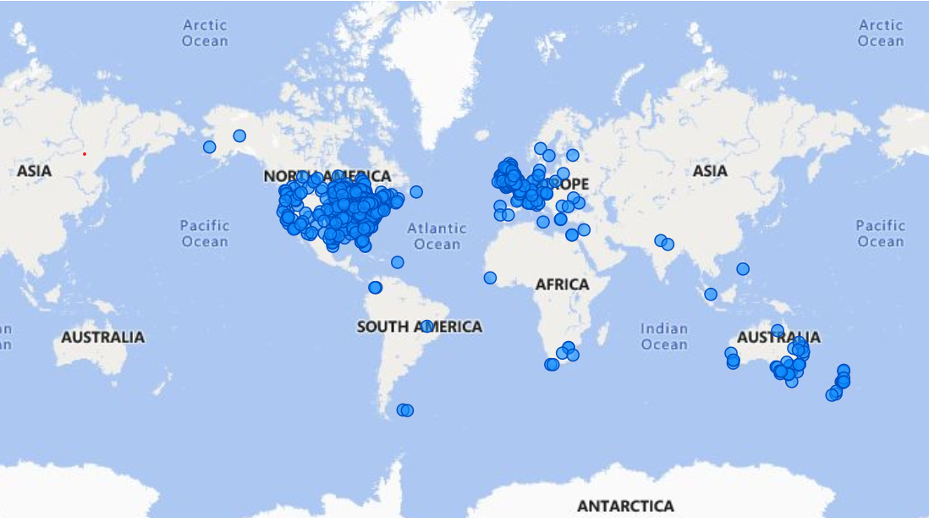
Geographical Region

Slide 9
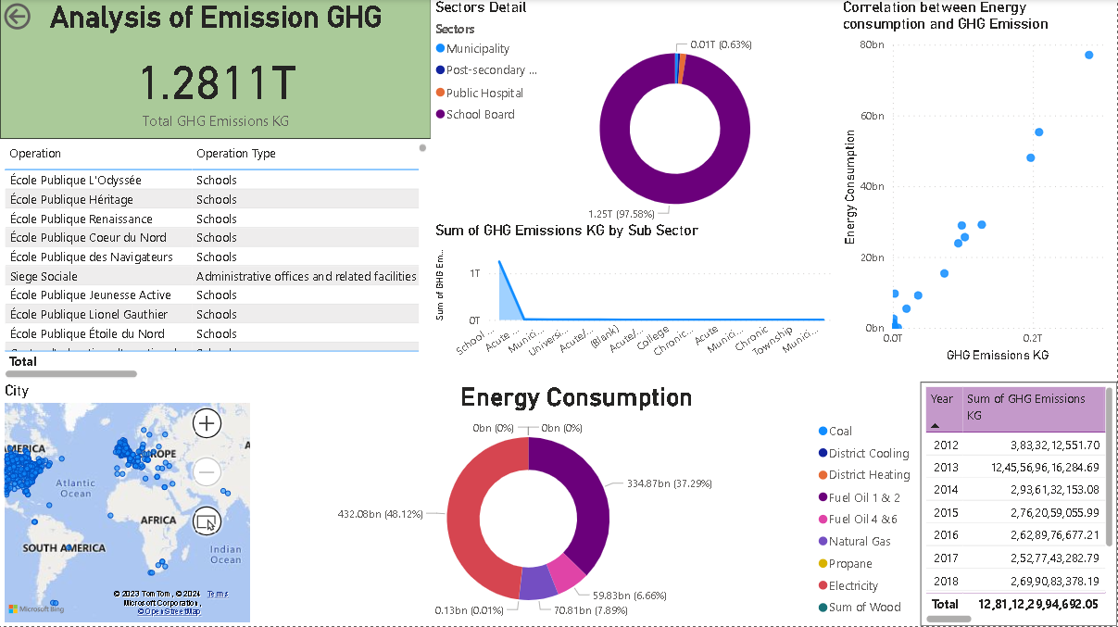

Slide 10
Conclusion/Suggestion
GHG Emission | Electricity | North Bay
École Publique L'Odyssée School has the highest emission of GHG | Electricity is most used energy source from the year 2012 to 2021 | North Bay from North America has emitted the highest GHG
PUBLIC SCHOOLS | 48.12% | 608.6066 bn

Slide 11
Suggestion
Highest GHG Emissions by School Board:
The School Board had the highest sum of GHG emissions at 12,49,47,09,28,854.68.
This value was 2,28,40,96,543.86% higher than the Municipal sector, which had the lowest sum of GHG emissions at 54,703.07.
School Board's Contribution:
The School Board accounted for a significant portion of the total GHG emissions, representing 97.53% of the sum of GHG emissions.
Range Across Sub Sectors:
The sum of GHG emissions across all 14 sub-sectors varied, ranging from 54,703.07 to 12,49,47,09,28,854.68.
This indicates a wide range of emissions across different sectors, emphasizing the need for targeted efforts to reduce emissions in high-emitting sectors.

